Slide 1
HAW–
Digital Industry
Sulzer Services – Tim Schulten – November 2022

Slide 2
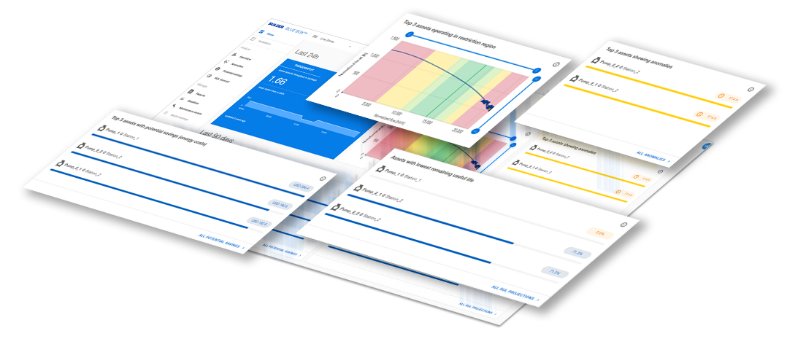
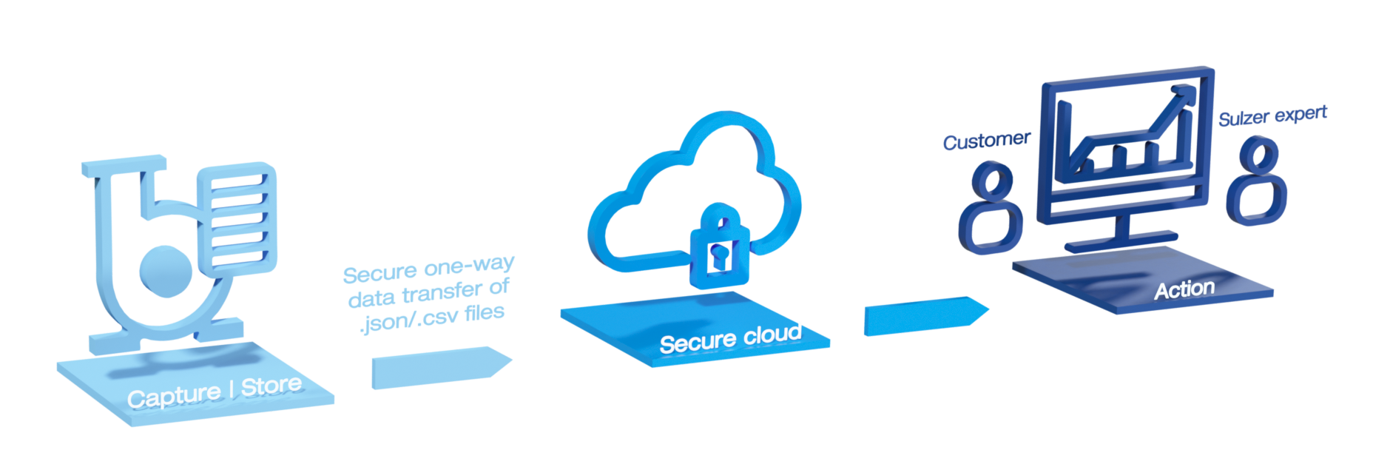
BLUE BOX™ pump-specific, AI-based Service offering
Data-driven decision support: Two elements to create customer value
1. | State-of-the art digital pump monitoring & analytics platform
2. | Expert support to turn analytics findings into customer business value
Real time analytics and KPI reporting
Performance and pump system debottlenecking
Reliability/Availability analysis gains time to act in time
Remaining pump life-time for risk-based maintenance
Potential savings and carbon reductions
Take out the complexity for clients in taking action
Ad-hoc incident mitigation calls
Monthly operations and maintenance calls
Quarterly optimization reports
Bespoke risk analysis reports to support client to build business case on esp. long-term optimization

Slide 3
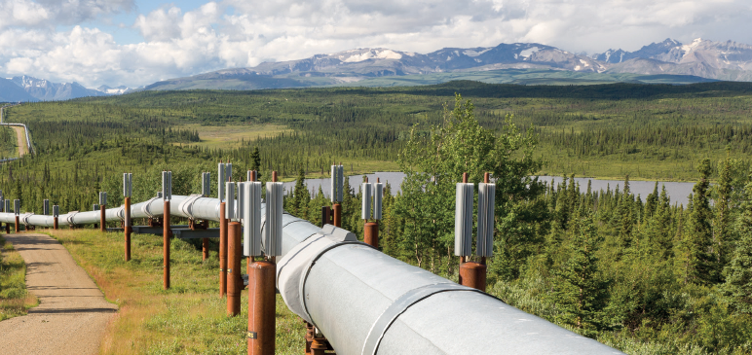
Success story: Major North American liquid pipeline
BLUE BOX™ enabled throughput increase, reduced lifecycle costs and carbon footprint
Customer situation
Pipeline reached capacity limit and customer wanted to sell more throughput Pumps partly operating at 150% BEP* above maximum flow at ope-rating stress and low efficiencies No visibility of pump performance
BLUE BOX solution
38 pumps are connected to BLUE BOX analytics platform Sulzer expert has detected through BLUE BOX continuous operation in restricted zone Retrofit options were developed for overall pipeline system optimization
Business outcome
Significant business value for customer along with 6 pump retrofits Increased overall pumping and pipeline system performance and flexibility Energy savings of 5-10% Increased pump reliability due to improved operation regimes

Slide 4
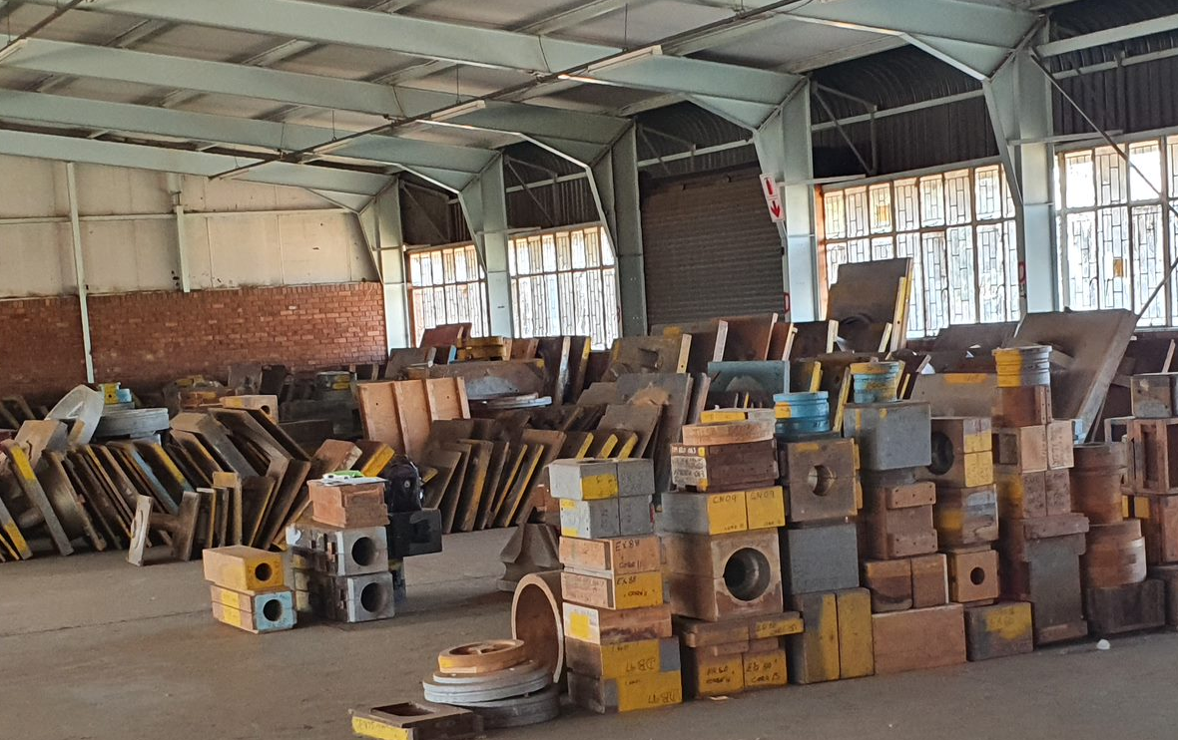
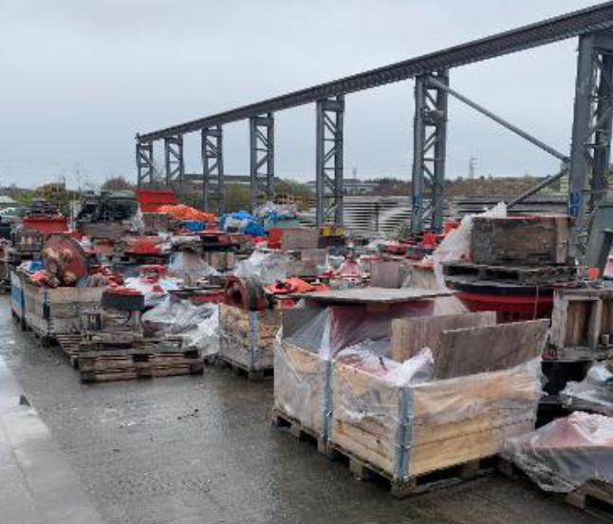
Digitization in spare parts manufacturing
Traditional casting process – inflexible and causing considerable cost
Old patterns, often stored in poor conditions, causing high storage cost.
Notes:
Sulzer is a manufacturer of large, high-energy pumps
Many components are casted.
In Service we often deal with legacy components, which were manufactured following a traditional casting process.
As a result, hundreds of wooden patterns are stored at casting suppliers, often in poor conditions, causing considerable cost.

Slide 5
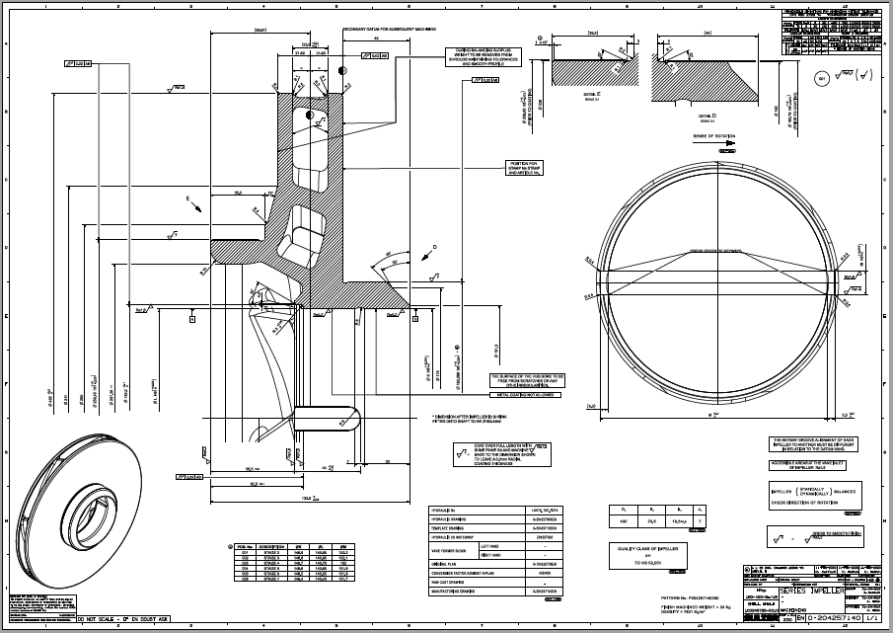
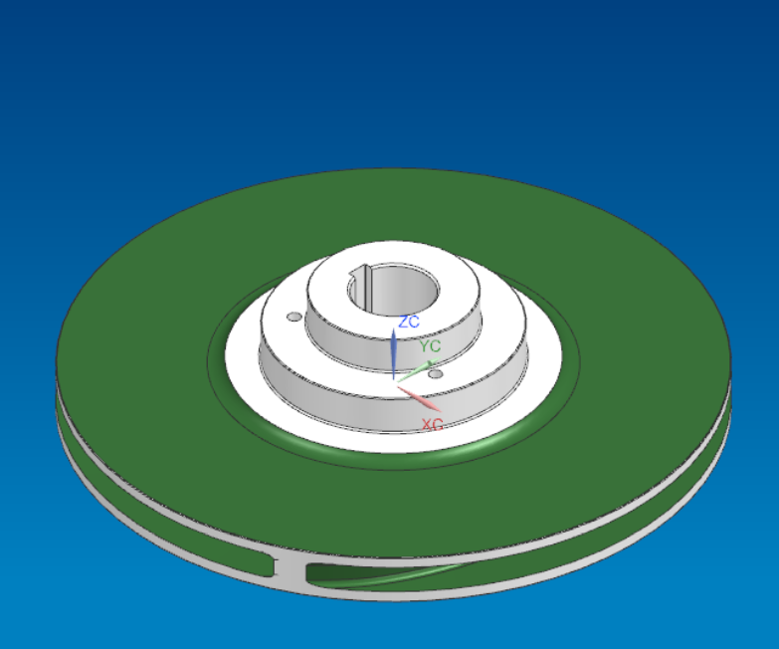
Converting thousands of old 2D drawings into 3D models…
Sulzer took the decision to convert most of its legacy designs into 3D models, in order to reduce lead times, increase supply chain flexibility and quality. With a team of 24 engineers more than 10’000 3D models will be created over a period of 10 years.

Slide 6
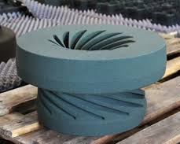
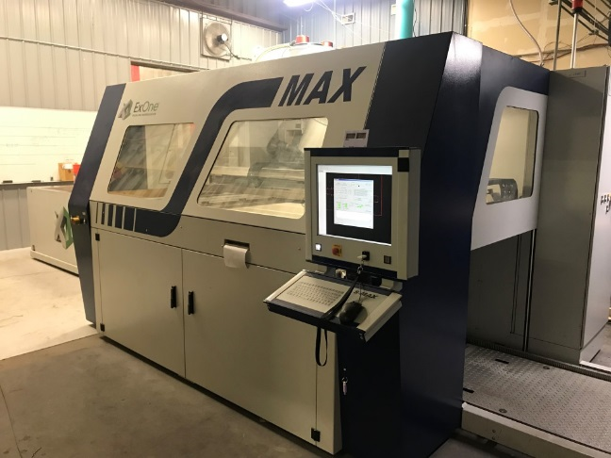
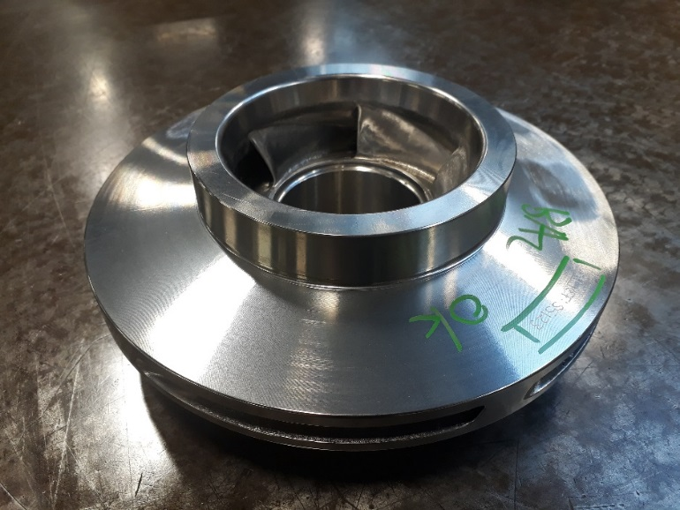
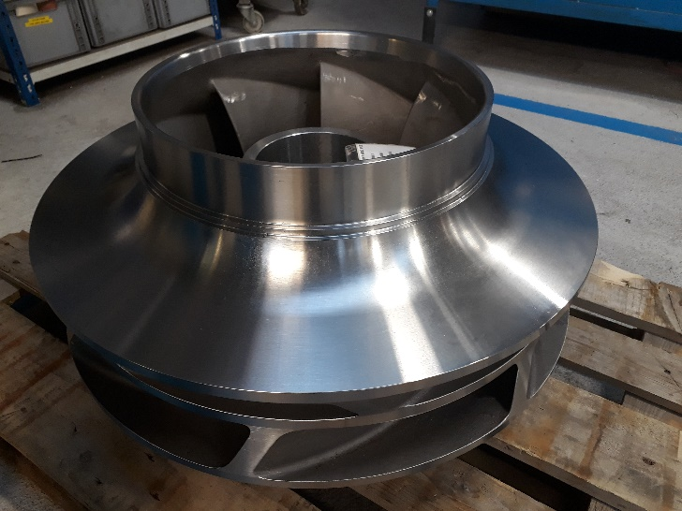
…provides the basis for many Additive Manufacturing processes
Polymer, Wax, and Binder Jetting are used today to create prototypes, sand moulds and investment casting patterns
Benefits
Cast from 3D models with no casting patterns
Reduced lead times
Supply chain flexibility
Higher quality castings

Slide 7
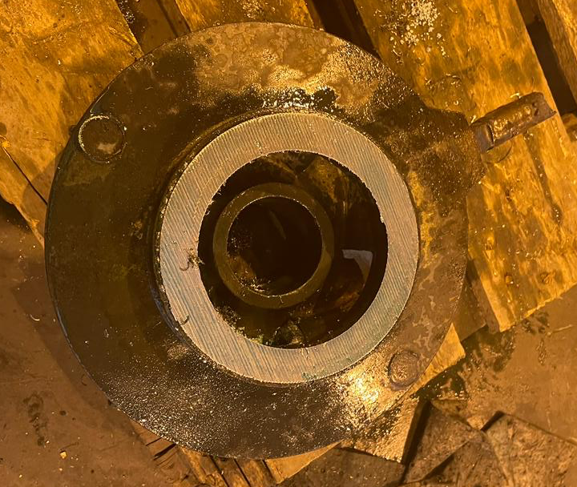
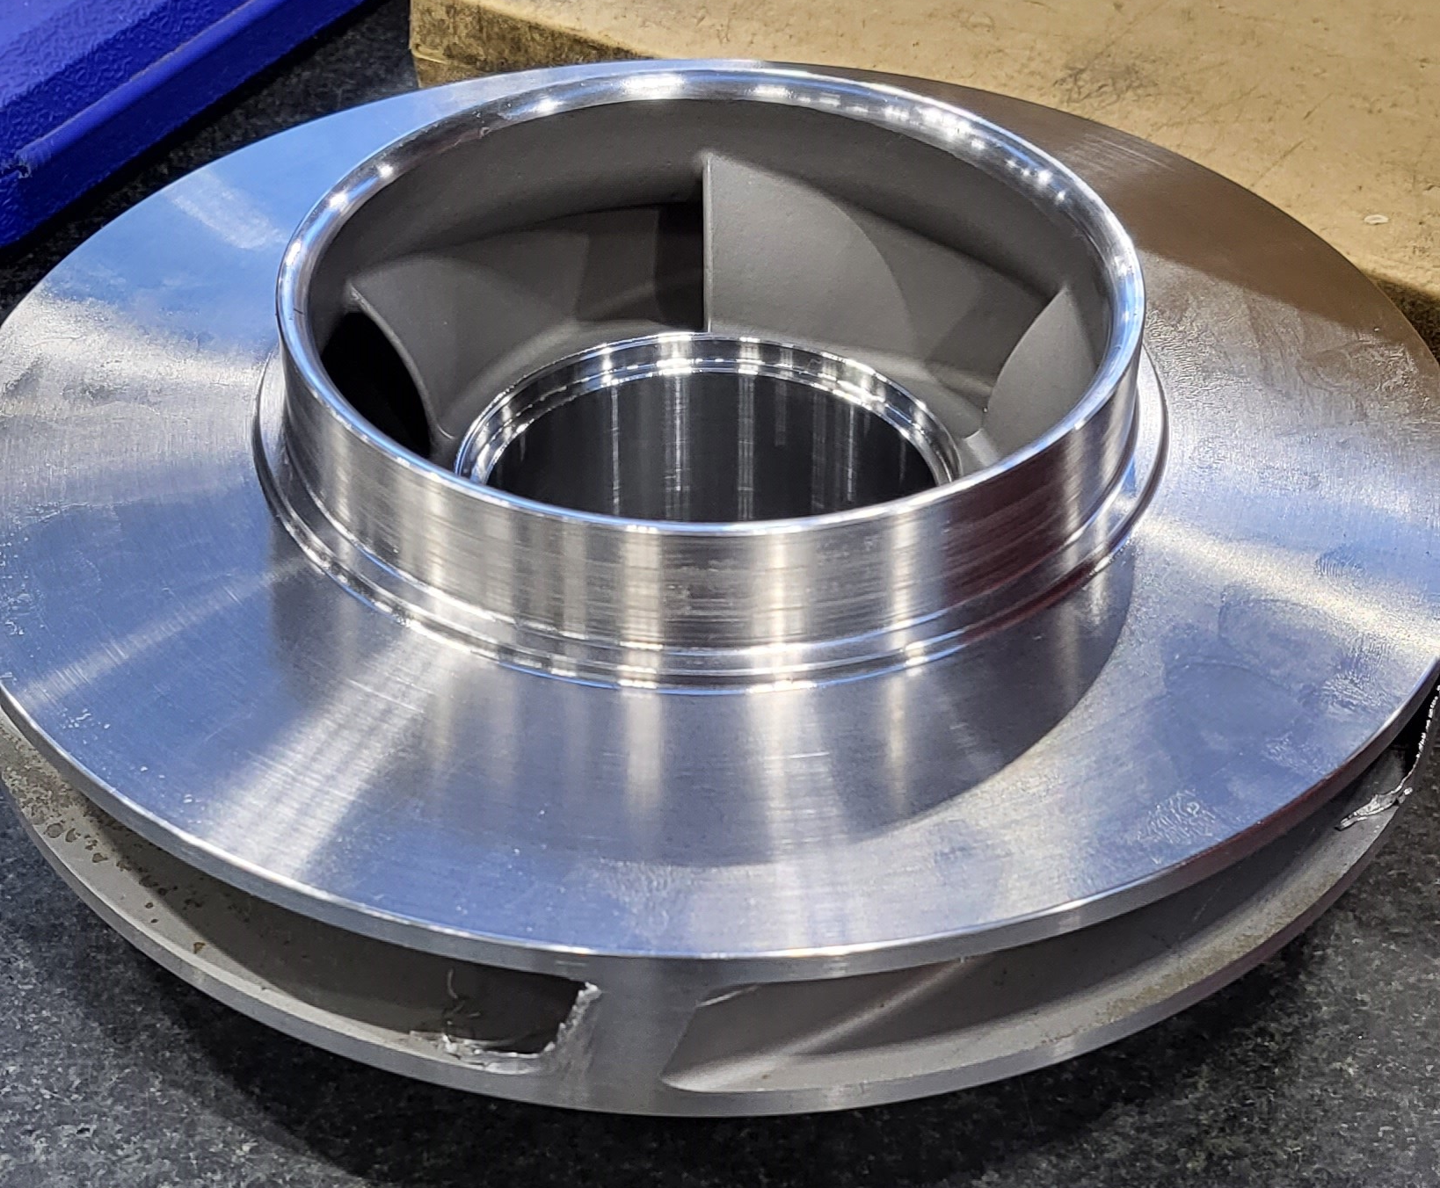
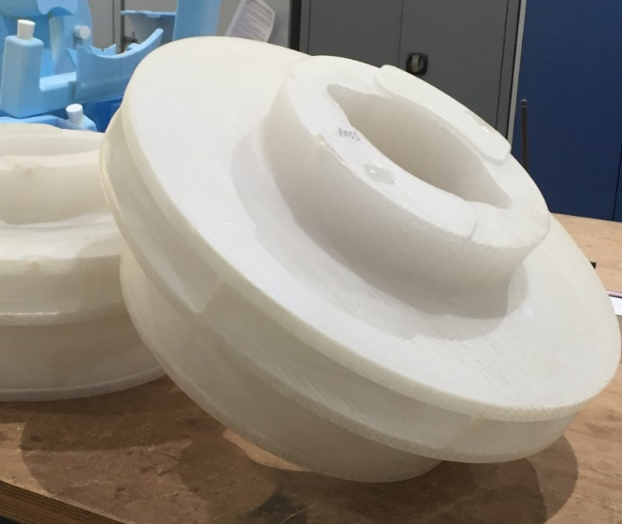
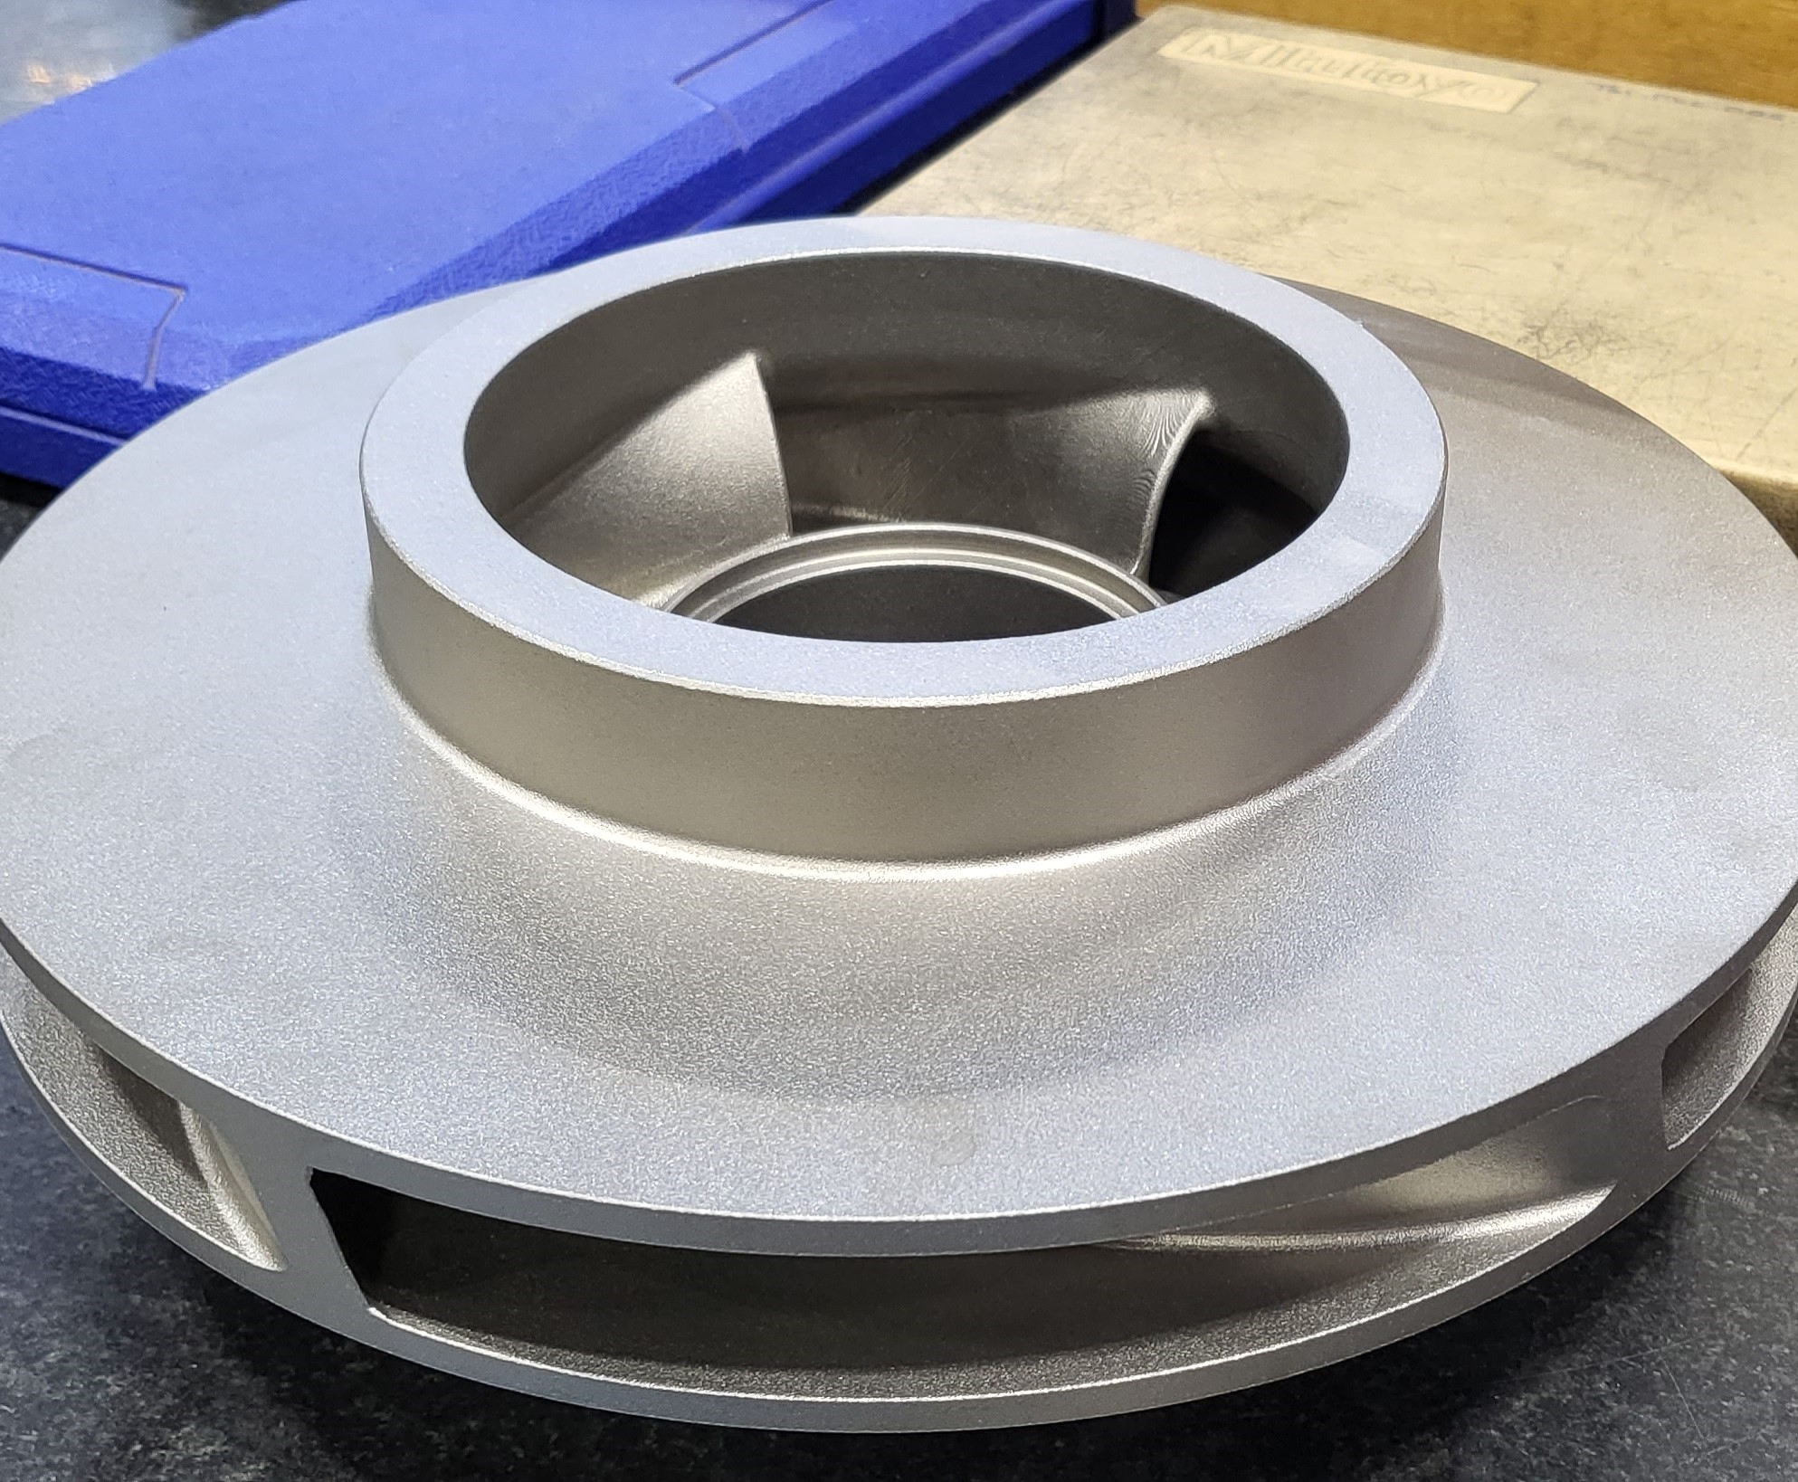
Combining additive manufacturing and traditional casting methods
Results & benefits
By combining additive manufacturing techniques with traditional casting processes Sulzer Services could reduce overall cost of casted parts, increase its supply chain flexibility and reduce lead times up to 50%, and thus gain orders, which could not be accepted before.
1. 3D printed pattern
2. Casting process
3. Casted impeller
4. Machined impeller

Slide 8
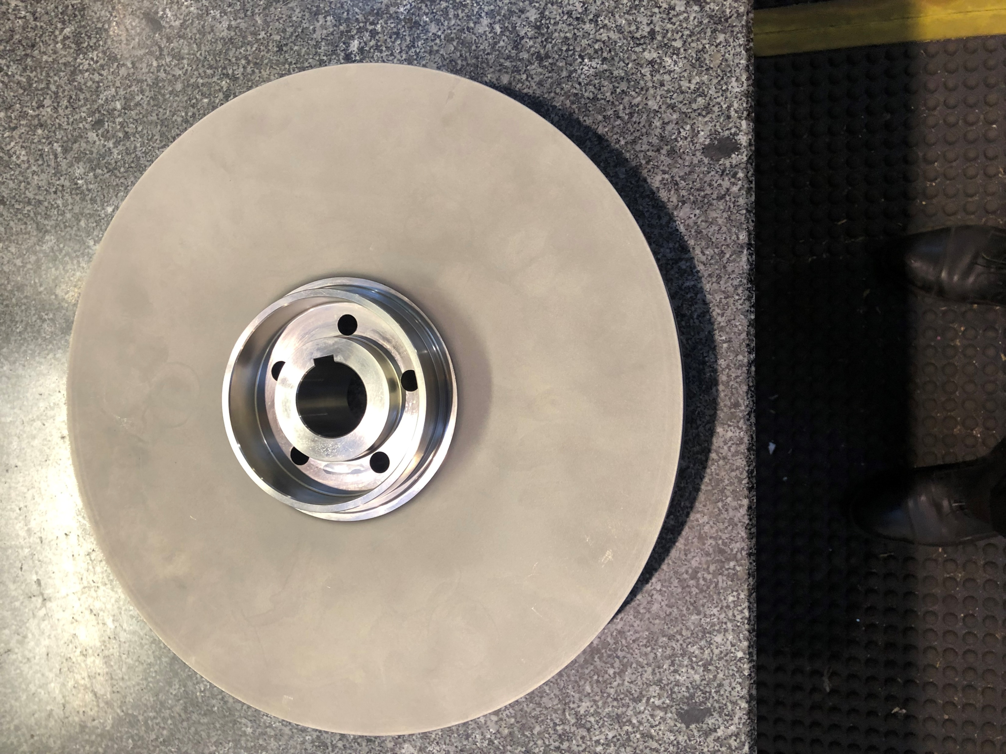
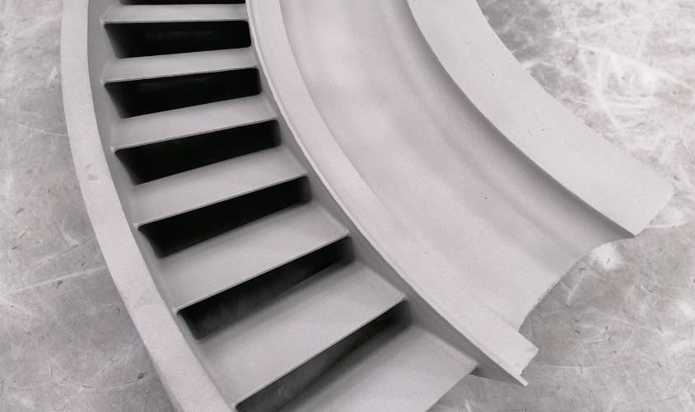
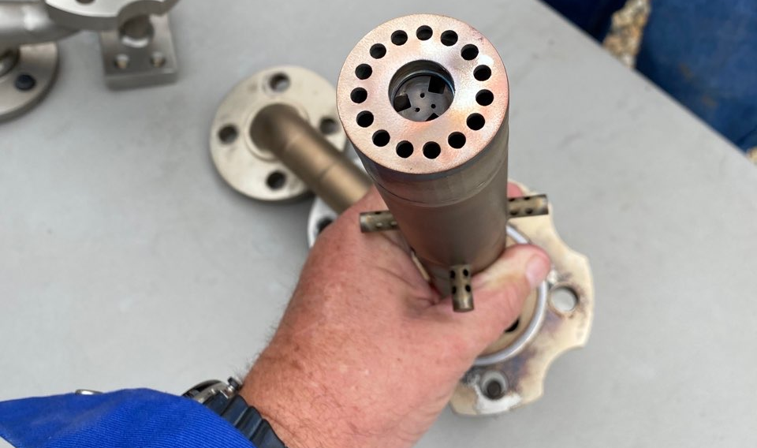
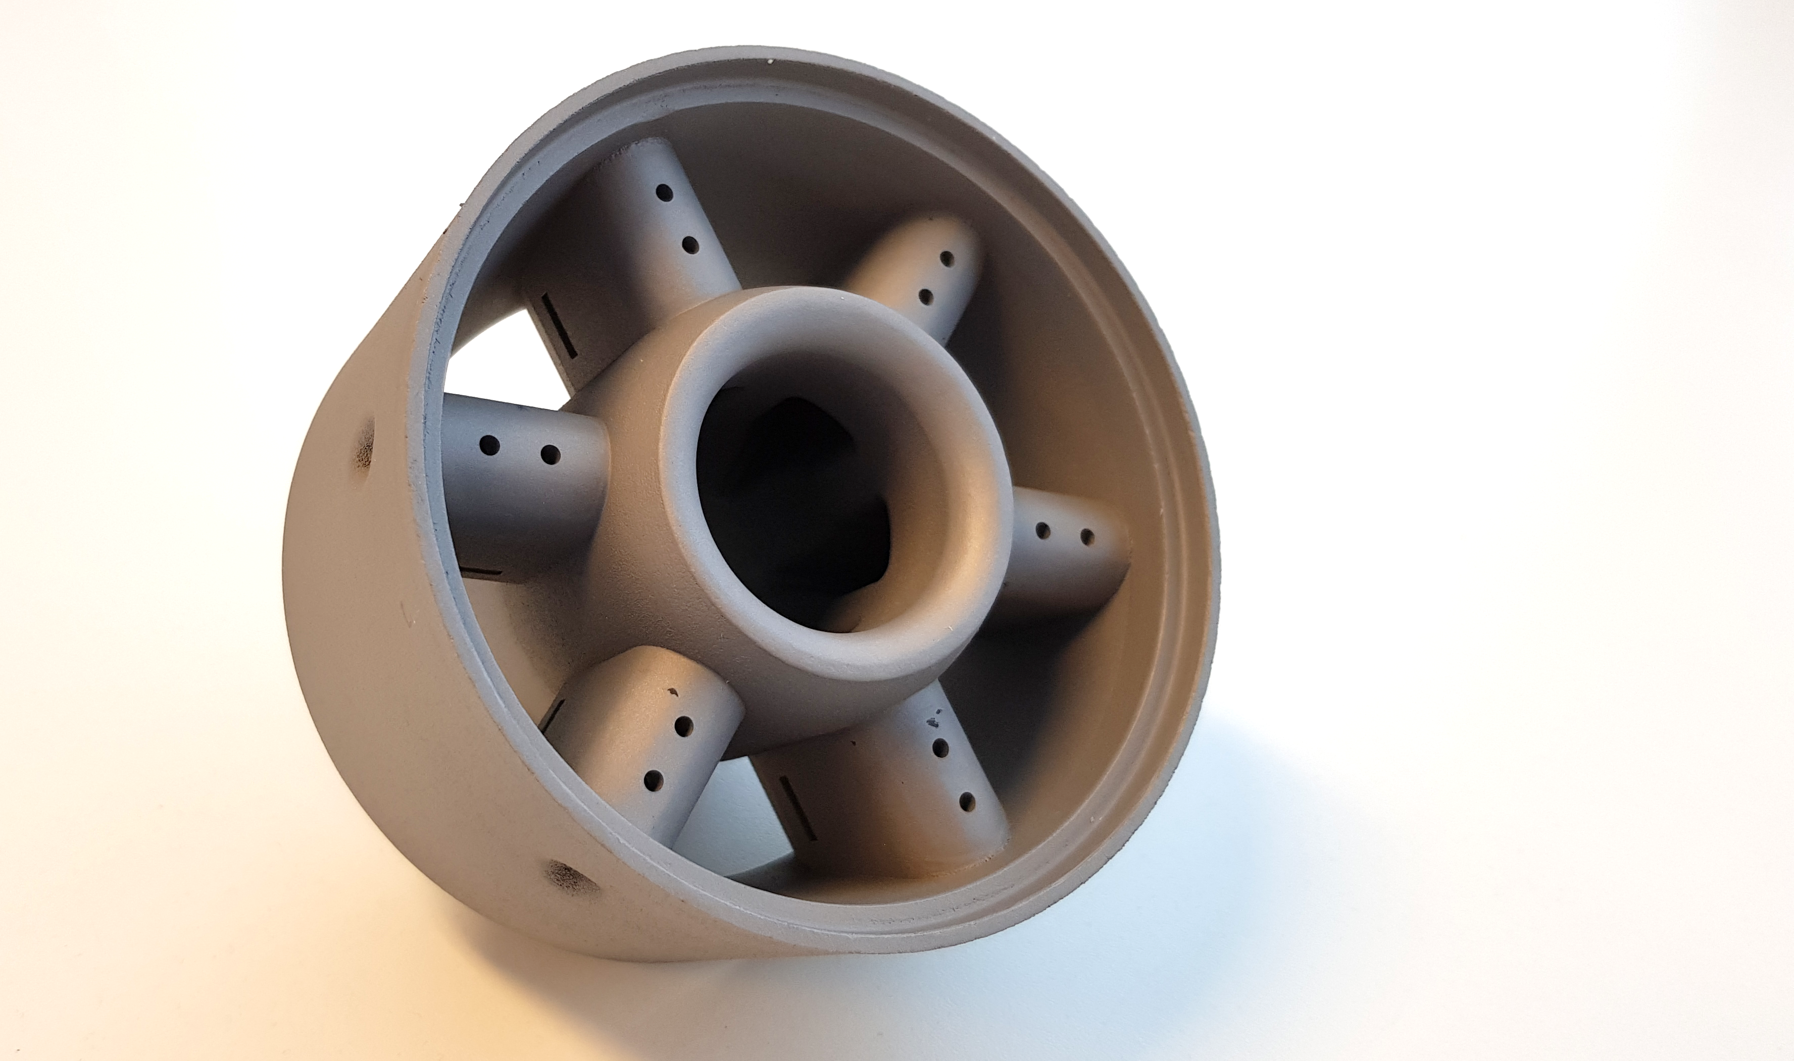
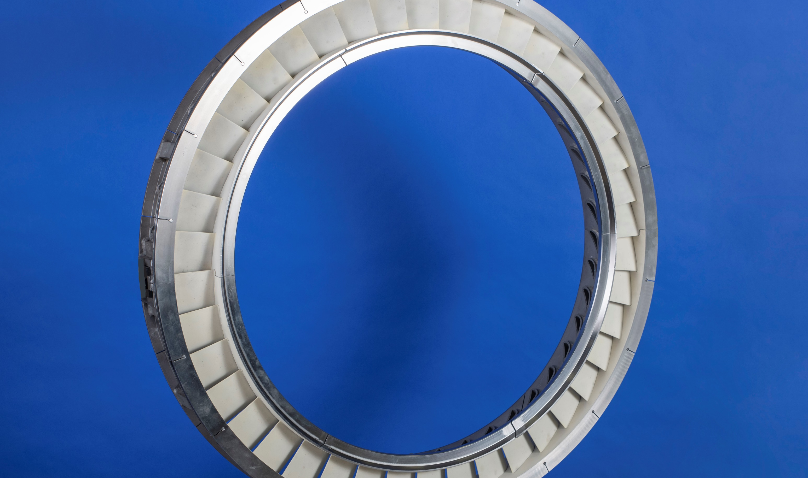
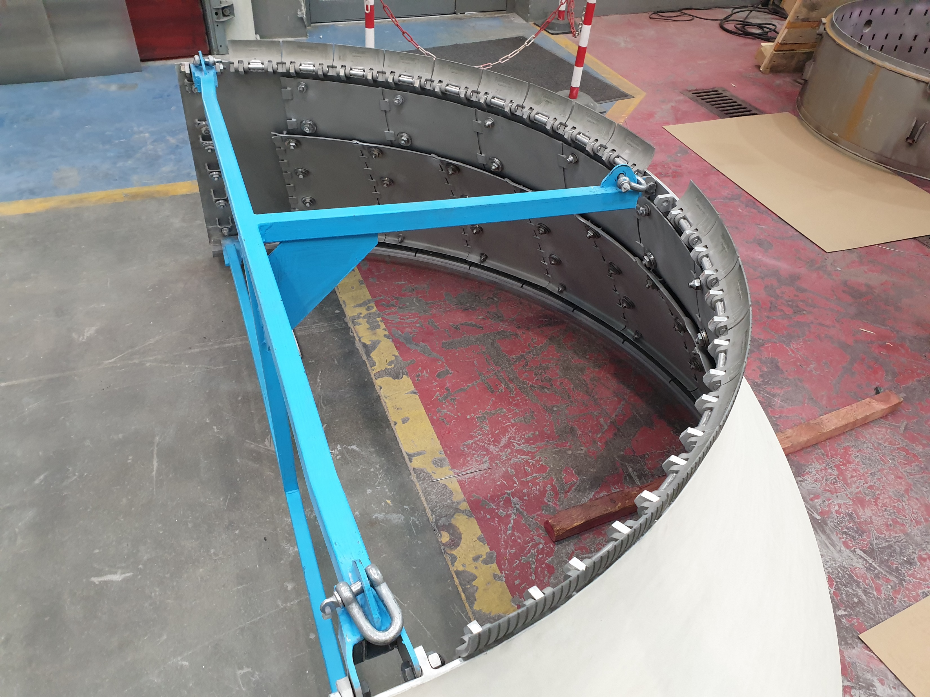
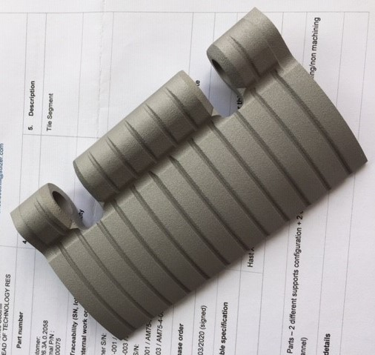
3D models driving use of SLM
Expander turbine segments
GT fuel tips
Pump impeller, 410mm
Range of parts commercialized; 1st part in operation since June 2020.
Total 179 in operation.
Internal qualification process and standards.
Experience through Joint Industrial Programs & Industry collaborations.
cMIST Mixers
GT stator ring
Combustor liners

Slide 9
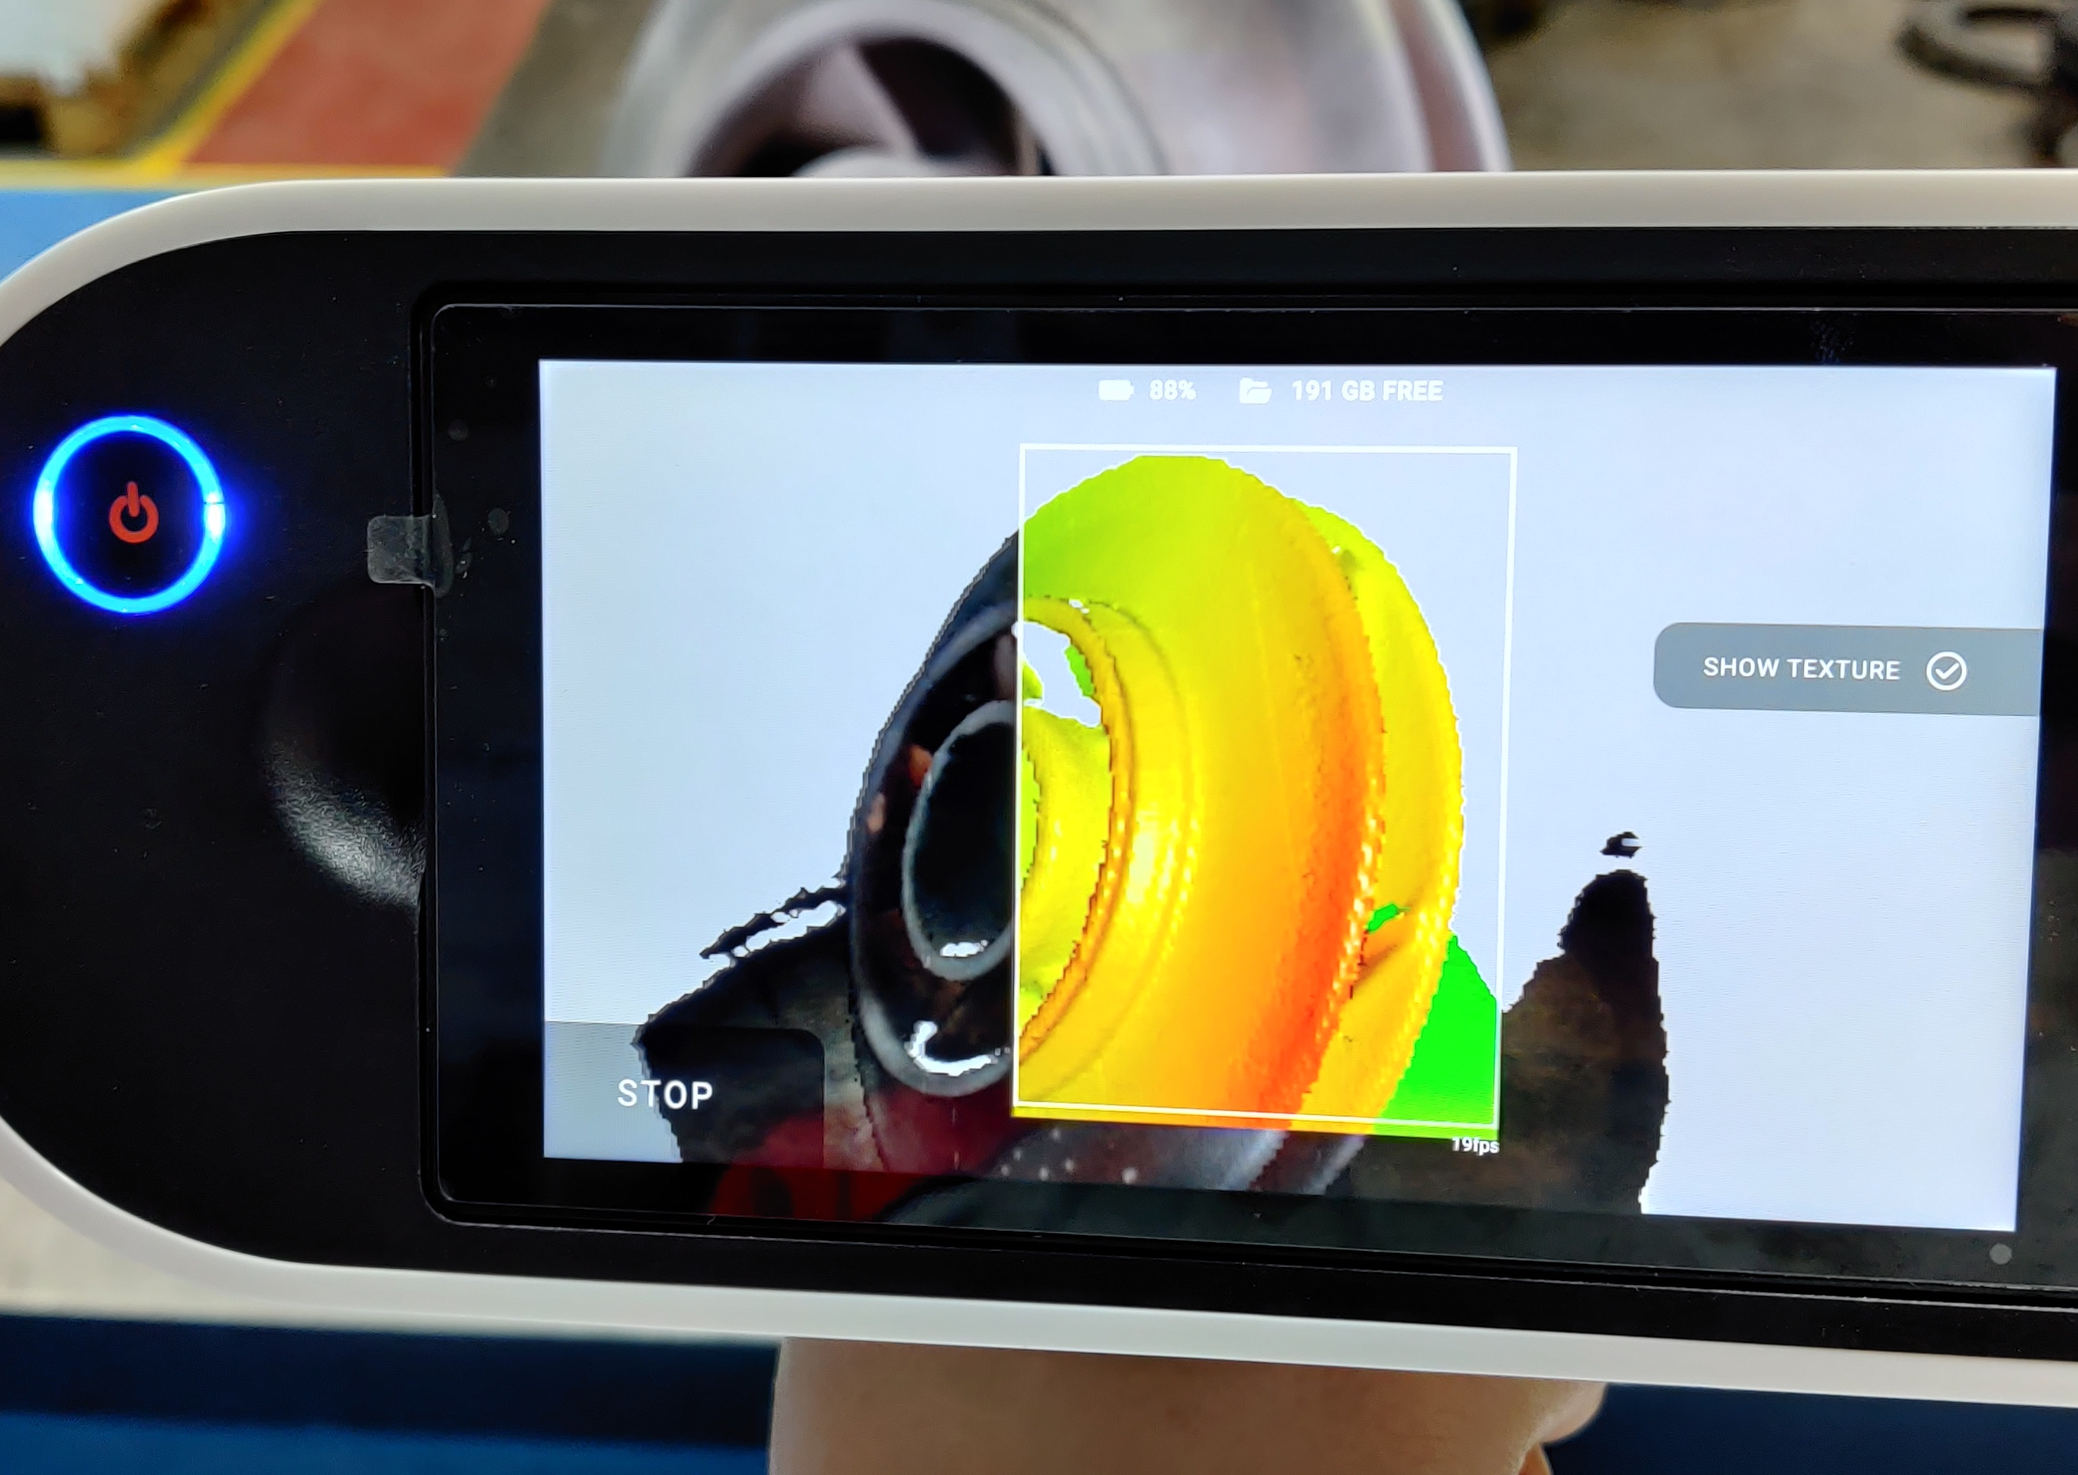
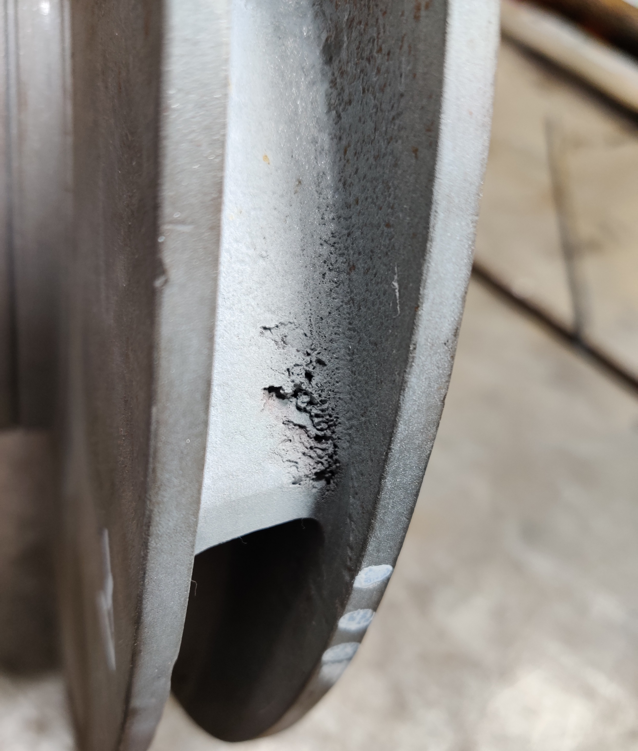
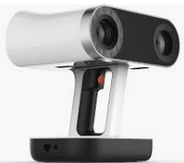
Scanning enabling Reverse Engineering
Fast, Accurate Scanning and Modelling of Legacy Parts
Portable and accurate optical scanners are used to collect original part geometry
Data can be collected in the field or workshop
Analysis and modelling is then performed using Sulzer/s OEM Engineering processes
Original damaged impeller
Artec optical scanner

Slide 10
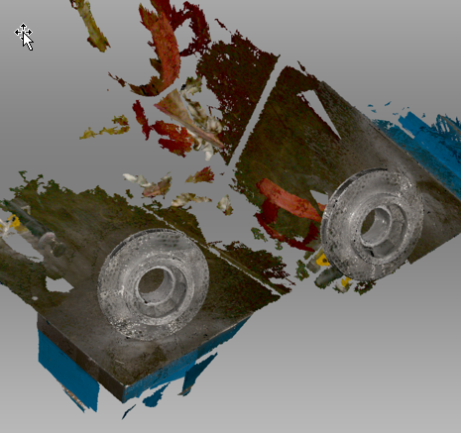

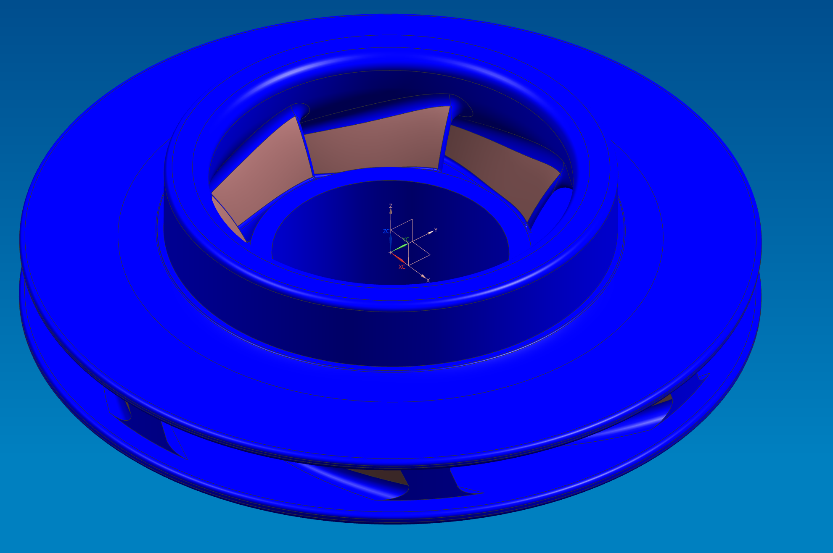
OEM Standard Engineering Processes
Scan data is run through post-processing software
Then hydraulic profile re-created using Sulzer hydraulic design software and knowhow
OEM quality model is created, ready for casting and manufacturing
Raw component scans
Vane construction
Final impeller model

Slide 11
Digital is…
Exciting
About priorities and focus
People
About application knowledge
A journey

Slide 12
Contact
Tim Schulten
Division President Services
P +41 52 262 31 40
E tim.schulten@sulzer.com
Sulzer Management Ltd
Neuwiesenstrasse 15
8401 Winterthur
Switzerland
sulzer.com

